Slide 1
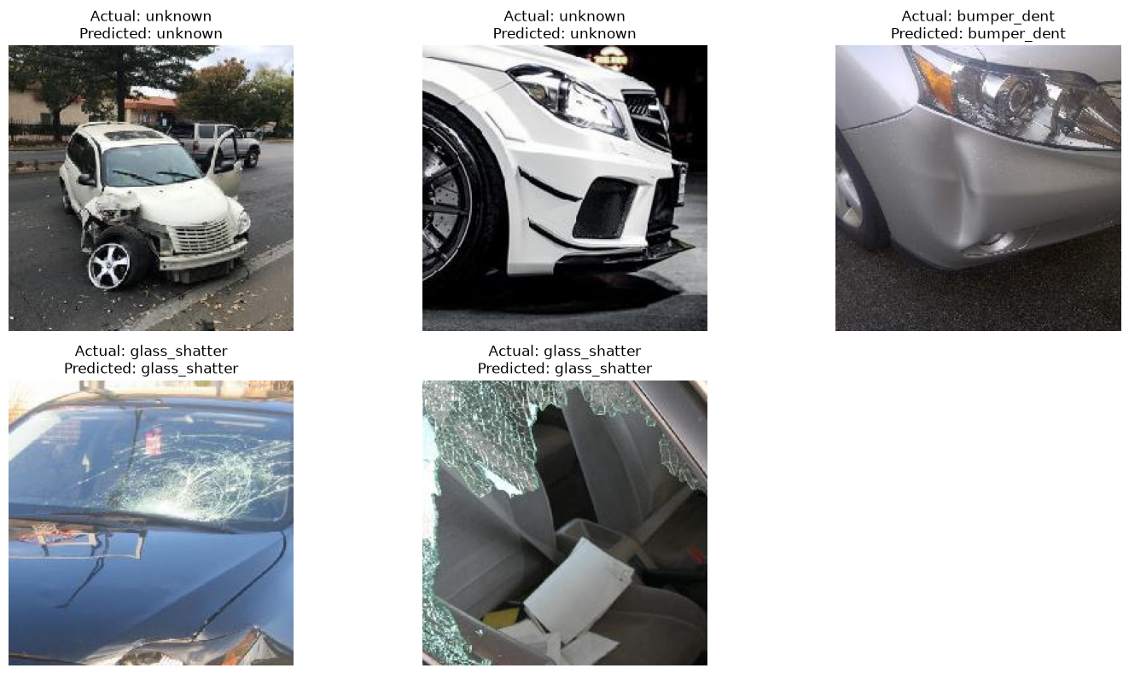
Car Damage Classification
A structured walkthrough of the notebook: data audit → preprocessing → scratch CNN → transfer learning → final model selection.
88.55%
1,512
8
best test accuracy
clean unique images
classes
Final champion: ResNet50 fine-tuned on car damage classes

Slide 2
PROJECT FLOW
The accuracy came from a staged, controlled process
The notebook did not jump directly to the final model. Each stage explained what to fix next.
1
Clean labels
4
Switch to transfer learning
Removed duplicate rows and kept 1,512 unique image-label pairs.
Used ImageNet-pretrained ResNet/EfficientNet features to improve generalization.
2
Audit images
5
Fine-tune gradually
Verified consistent 224×224 RGB JPEG inputs and checked class balance.
Started with classifier heads, then unfroze deeper convolution blocks.
3
Build baseline
6
Select champion
Trained a scratch CNN to establish a from-scratch reference point.
Compared test accuracy, reports and confusion matrices; ResNet50 became best.
Key idea
Every change was tested as an experiment. When a model underperformed, we did not keep tuning it blindly; we moved to the next controlled option.

Slide 3
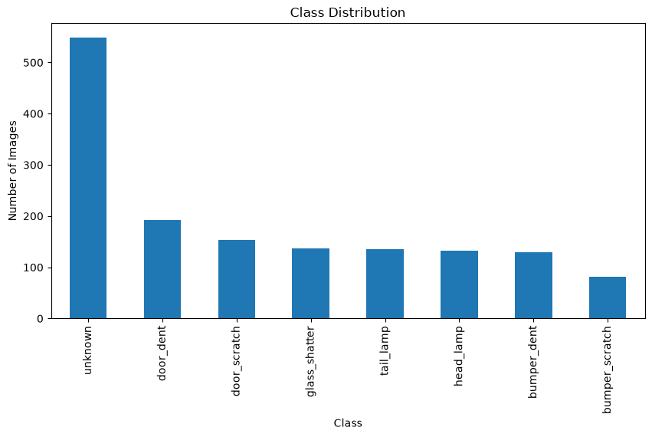
DATA AUDIT
Data quality was clean; class balance was the real risk
The dataset was already standardized, so preprocessing focused on augmentation and correct evaluation.
1512
224×224
RGB JPEG
36.31%
unique rows after duplicate cleanup
fixed resolution
same format / channels
unknown class share
No resizing logic was needed because every image was already 224×224.
Dataset-specific mean/std was used for the scratch CNN.
ImageNet normalization was used for pretrained models.
Stratified splitting preserved class proportions across train, validation and test.

Slide 4
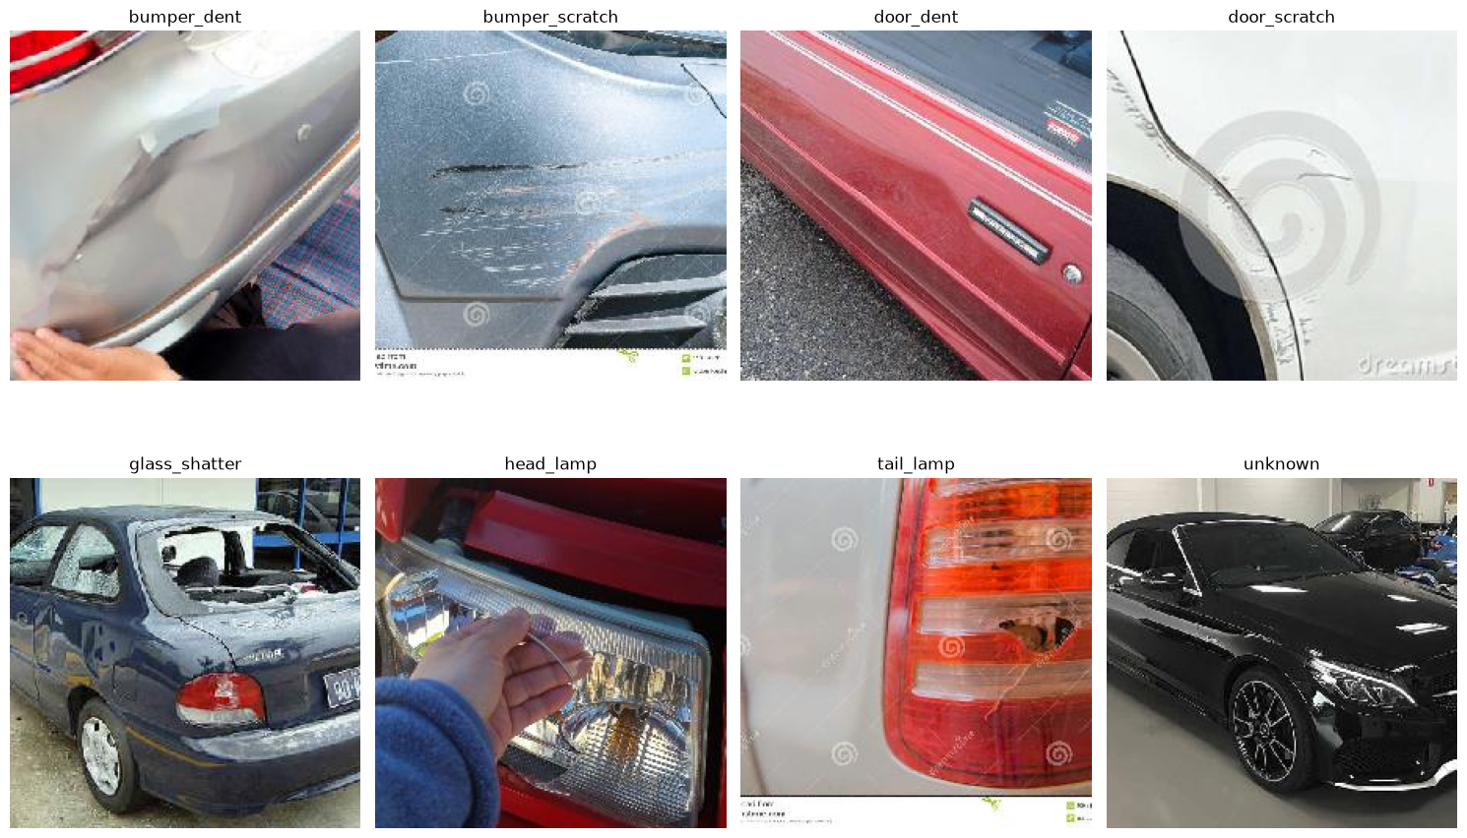
LABEL UNDERSTANDING
Before modeling, we checked what each class visually meant
This helped decide safe augmentations and made class overlap visible before training.
What this revealed
Damage classes are not equally easy. Lamp and glass classes are visually distinctive, while dent/scratch classes can overlap depending on the crop and car part.
Augmentation choice
We used mild flips, rotations, lighting jitter and small affine shifts. Aggressive crops were avoided because they could remove the damaged area.

Slide 5
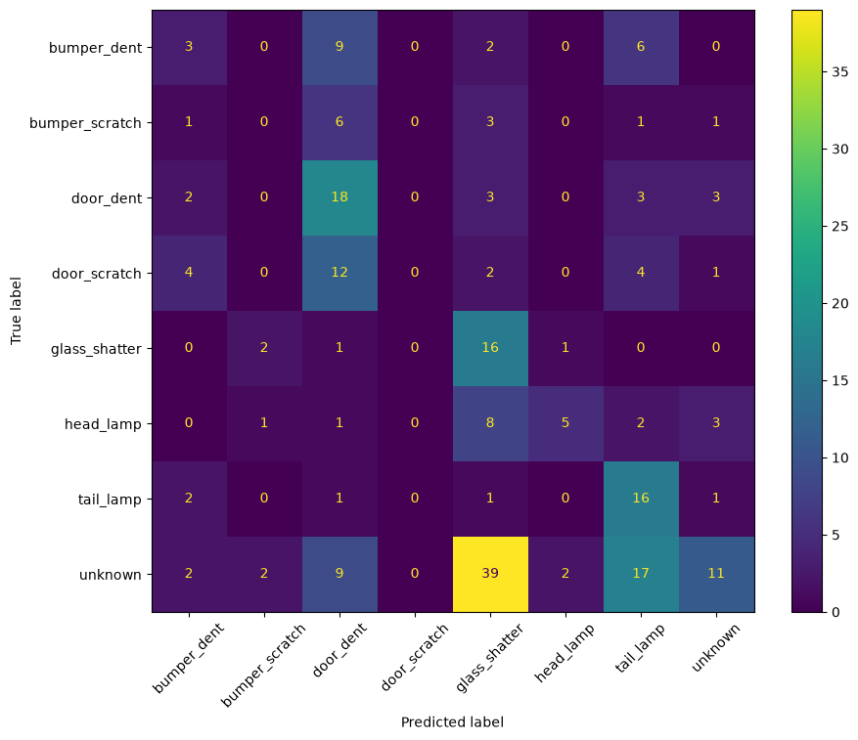
BASELINE LEARNING
Scratch CNN V1 showed why transfer learning was needed
The from-scratch model learned some patterns but could not build strong visual features from ~1k training images.
30.40%
1058
8
Scratch CNN V1 test accuracy
training images
target classes
The confusion matrix was scattered instead of strongly diagonal.
Minor classes were especially weak because the model learned limited low-level features.
The model had to learn both general car features and damage-specific features from a small dataset.
This made pretrained CNN backbones the next logical move.

Slide 6
TRANSFER LEARNING
Pretrained backbones solved the feature-learning problem
Instead of learning edges, textures and car-part representations from scratch, models reused ImageNet features and fine-tuned them.
Stage 1: train classifier head
Stage 2: fine-tune last block
Stage 3: fine-tune more carefully
Freeze the pretrained backbone and train only the final classification layer for the 8 damage classes.
Unfreeze the deepest feature block, use a lower learning rate and adapt higher-level features to car damage.
For ResNet18, layer3 + layer4 improved results. For some larger models, extra tuning did not always help.
Process
Reusable training/evaluation functions made experiments consistent.
Checkpointing by validation loss protected against bad final epochs.
The same test set was kept untouched for fair comparison.

Slide 7
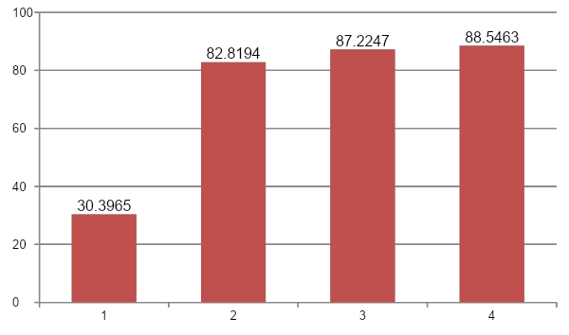
MODEL COMPARISON
ResNet50 won, but ResNet18 was very close
The final result came from comparing architectures under the same split and evaluation process.
Result interpretation
Scratch CNN V1 established the difficulty of the task.
EfficientNet-B0 improved a lot but did not beat ResNet.
ResNet18 performed strongly after staged fine-tuning.
ResNet50 produced the best test accuracy: 88.55%.
Decision
Keep ResNet50 as the final model, but record ResNet18 as a strong fallback because it is smaller and only ~1.3 points behind.

Slide 8
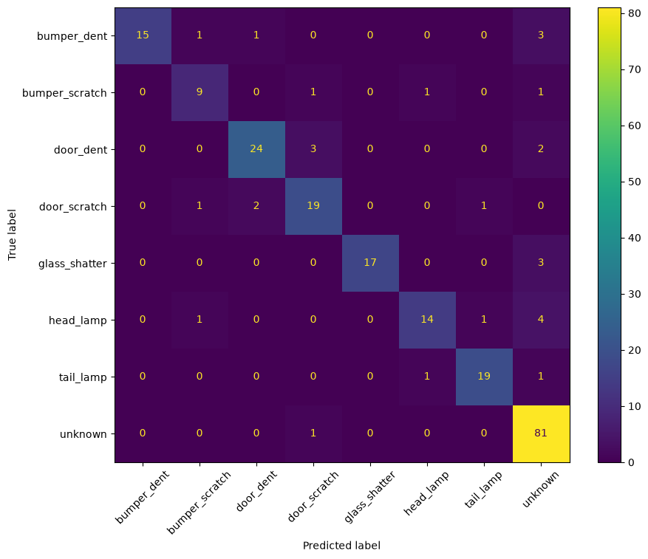
RESNET18 REVIEW
ResNet18 showed the right fine-tuning pattern
Accuracy improved when we moved from head-only training to deeper block fine-tuning.
87.22%
ResNet18 final test accuracy
Layer3 + layer4 fine-tuning gave the strongest ResNet18 result.
Unknown, tail_lamp, glass_shatter and bumper_dent became strong classes.
Head_lamp still had weaker recall, showing it needed more data or targeted improvement.
Full unfreezing later reduced performance, so extra complexity was not automatically better.

Slide 9
ARCHITECTURE DECISIONS
Not every stronger architecture improved the result
The project improved by keeping experiments and decisions disciplined.
EfficientNet-B0
ResNet50
What went wrong earlier
Reached 82.82%, but dropped below ResNet18. We stopped tuning it instead of forcing a worse branch.
Reached 88.55%, becoming the best final model. It improved class-level performance without adding fragile tricks.
A checkpoint filename from ResNet18 was reused in a ResNet50 block. The cleaned notebook fixes this with model-specific names.
Why ResNet50 won
Why we stopped there
Deeper pretrained features helped without overcomplicating the pipeline.
Fine-tuning layer4 was enough to beat ResNet18 and EfficientNet-B0.
Class-level results remained balanced: macro F1 0.87 and weighted F1 0.89.
Extra experiments should now target the remaining error patterns, not repeat similar ResNet tuning.
The next real 90%+ attempt should be ConvNeXt, TTA or a ResNet18 + ResNet50 ensemble.

Slide 10
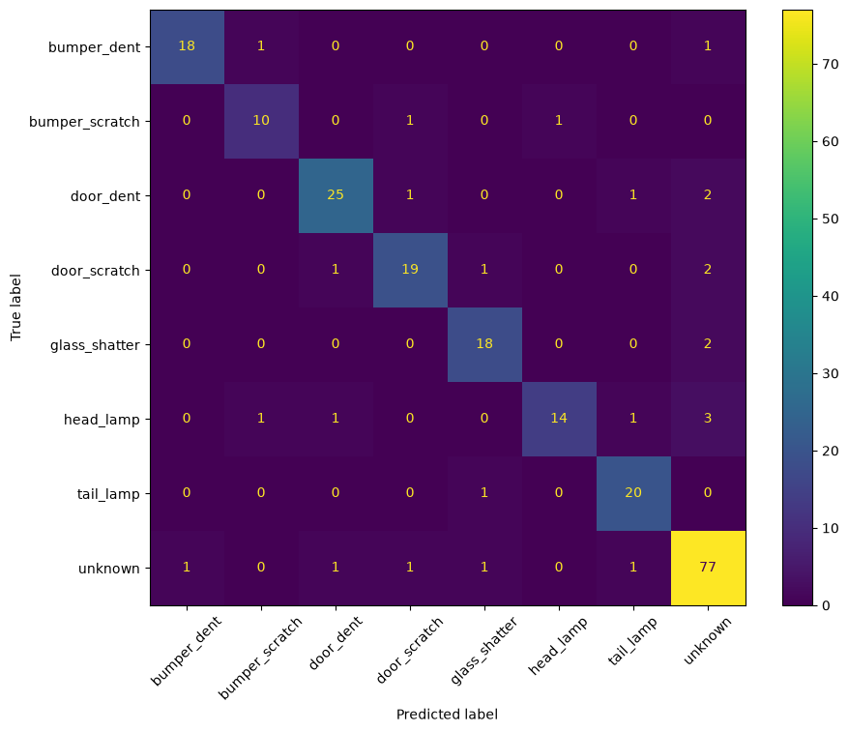
FINAL MODEL
ResNet50 final readout: strong overall and class-level performance
The final confusion matrix is strongly diagonal, with head_lamp still the main recall gap.
88.55%
0.87
0.89
test accuracy
macro F1
weighted F1
Class
F1
bumper_dent
0.92
Main remaining gap
bumper_scratch
0.83
door_dent
0.88
Head_lamp recall is lower than the rest. The next improvement should focus on head_lamp examples and confusions, not a generic retry of the same architecture.
door_scratch
0.84
glass_shatter
0.88
head_lamp
0.80
tail_lamp
0.91
unknown
0.91

Slide 11
PREDICTION CHECK
The final model was tested like a deployable classifier
A prediction function was used to show image, actual class and predicted class on unseen test samples.
This step matters because the notebook moved beyond aggregate metrics: it checked whether a saved model can take a new image and return an interpretable class.

Slide 12
Future Improvements
The current model is strong, but 90%+ will likely need targeted improvement rather than more random tuning.
1. Keep ResNet50 as champion
2. Improve weak classes
3. Try new experiments
Save final_best_resnet50.pt and class_to_idx.json. Use these for inference and future comparison.
Inspect head_lamp and bumper_scratch mistakes. Add more labelled samples or targeted augmentation for these cases.
Next experiments: ConvNeXt-Tiny, test-time augmentation, and ensemble averaging of ResNet18 + ResNet50 logits.
Current benchmark to beat
ResNet50: 88.55% test accuracy, macro F1 0.87, weighted F1 0.89

